Slide 1
NetApp FAS6220 cDOT Shared Standard Architecture
Mike Arndt, Systems Engineer
2013-10-23

Slide 2
Overview
Clustered Data ONTAP (cDOT) 8.2
Non-disruptive operations and QOS enabled by CDOT
8.2.1GA expected in January 2014 and recommended for shared systems
Primary storage cluster design
A mix of high tier and low tier HA pairs in each cluster
8 node maximum (4 HA pairs) to support QOS
FlashPool based design for High Tier
The mix of SSD and 600GB 10k SAS drives mitigate performance impact of the industry moving away from 15k drives
SATA with FlashCache design for Low Tier
Keep cost down for applications without high performance requirements by using 2TB SATA drives
SnapVault secondary system design
Single node system
DS4486 disk shelves with 4TB drives provide low cost and high density for backup systems

Slide 3
High Tier
High Tier Standard Architecture:
FAS6220 HA Pair
DS2246 shelves of 600GB 10k SAS drives
6 shelves in base configuration
12 shelves in maximum configuration
DS2246 shelves of 200GB SSD drives
2 shelves of 12 drives
1500GB of cache per controller
10GbE connectivity for data access
1GbE connectivity for management
Software licenses:
NFS and CIFS protocols
SnapMirror, SnapVault, and SnapRestore

Slide 4
High Tier: Performance Scaling
Base configuration of 3 shelves per controller:
27TB usable per controller
Maximum configuration of 6 shelves per controller:
56TB usable per controller
Peak throughput at 32k 50/50 read/write mix:
1054MB/sec per controller
33,750 IOPs per controller
Peak IOPs at 4k 50/50 read/write mix:
53,000 IOPs per controller
207MB/sec per controller
Performance profile limits:
18.8MB/sec per TB
946 IOPs per TB
These values assume possible performance degradation during a cluster failover event

Slide 5
Low Tier
Low Tier Standard Architecture:
FAS6220 HA Pair
DS4246 shelves of 2TB 7.2K SATA drives
4 shelves in base configuration
6 shelves in maximum configuration
512GB of FlashCache per controller
10GbE connectivity for data access
1GbE connectivity for management
Software licenses:
NFS and CIFS protocols
SnapMirror, SnapVault, and SnapRestore

Slide 6
Low Tier: Performance and Capacity Scaling
Base config of 2 shelves per controller:
52TB usable per controller
Maximum config of 3 shelves per controller:
78TB usable per controller
Peak throughput at 32k 50/50 read/write mix:
687MB/sec per controller
22,000 IOPs per controller
Peak IOPs at 4k 50/50 read/write mix:
36,000 IOPs per controller
140MB/sec per controller
Performance profile limits:
8.6MB/sec per TB
461 IOPs per TB
These values assume possible performance degradation during a cluster failover event

Slide 7
SnapVault Secondary
SnapVault Secondary Standard Architecture:
FAS6220 single node cDOT system
Single node systems are preferred to accommodate cluster peer limitation of 8 peers per cluster
DS4486 shelves of 4TB 7.2K SATA drives
1 shelves in base configuration
4 shelves in maximum configuration
Based on estimations of hitting 1000 volume limit
10GbE connectivity for data access
1GbE connectivity for management
Software licenses:
NFS and CIFS protocols
FlexClone, SnapMirror, SnapVault, and SnapRestore

Slide 8
Cluster Network
FAS6220 shared primary storage configured as switched clusters at initial installation
NetApp CN1610 cluster network switches
Low cost NetApp branded switch
No customer setup required, complete config available from support.netapp.com
Supports up to 8 node clusters
SnapVault secondary will be configured as single node systems
8 cluster peers are supported per cluster, so configuring single node backup systems helps avoid hitting the cluster peer limit

Slide 9
Requirements / Limitations in cDOT 8.2.1
1000 volumes per controller
125 Vservers per controller
125 LIFs per controller
10M maximum distance from controllers to all disk shelves
5M distance from controllers to private cluster switches with copper cabling
300M distance from controllers to private cluster switches with optical cabling
8 cluster peers

Slide 10
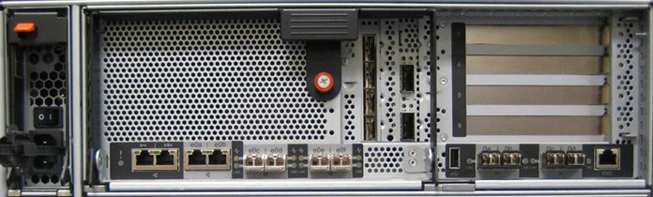
FAS/V6200 Controller I/O Standalone Controller
PCIe v2.0
Slots
GbE
NVRAM8
(Slot 2)
USB
(disabled)
e0a, e0b
Vertical I/O
Slot 1
Slots 3,4,5,6
A single stack will be used for
e0M / SP
e0c, e0d, e0e, e0f
0a, 0b, 0c, 0d
Serial
Console
Management
ACP
10GbE
8Gb FC
10/100 Ethernet

Slide 11
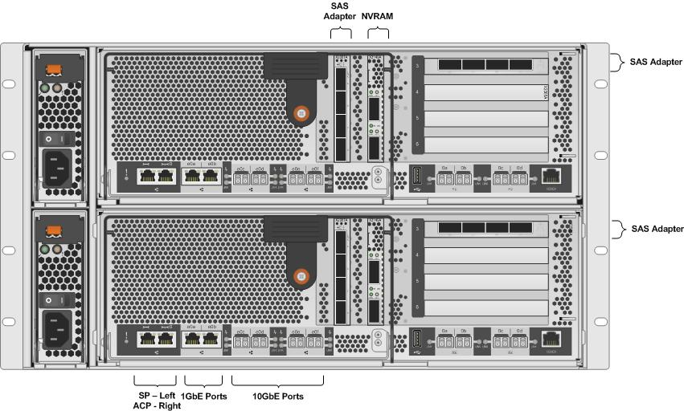
High Tier Controller Configuration Details

Slide 12
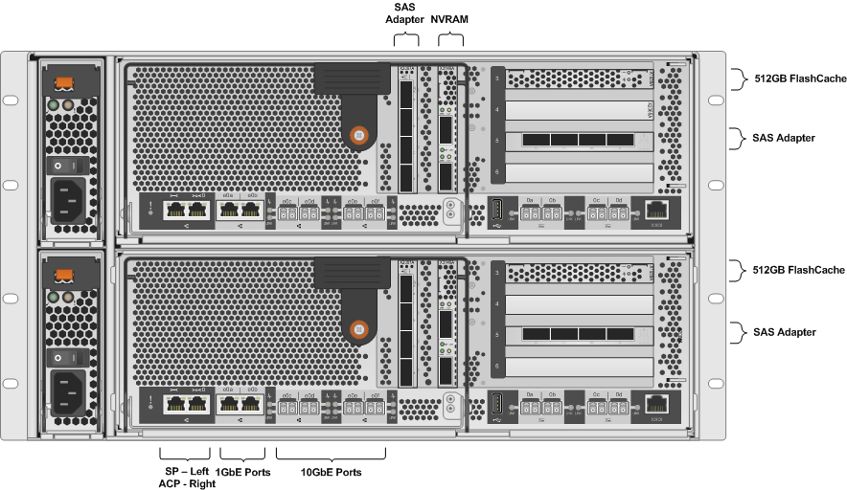
Low Tier Controller Configuration Details

Slide 13
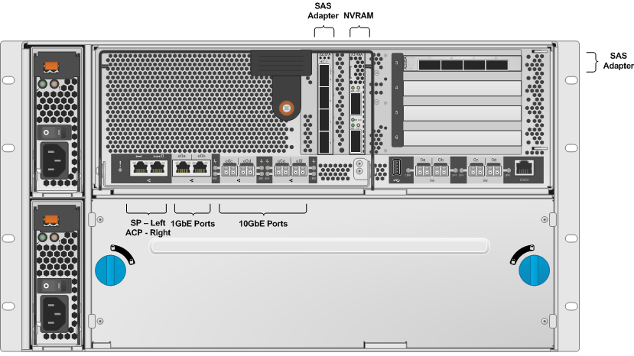
Backup Controller Configuration Details

Slide 14
HA Pair SAS Connectivity
Cable shelf to shelf IOMs from OUT ● to IN ■
First stack shelf IDs start with 00 and count up
Second stack shelf IDs start with 10 and count up

Slide 15
Single Controller SAS Connectivity
Cable shelf to shelf IOMs from OUT ● to IN ■
First stack shelf IDs start with 00 and count up
Second stack shelf IDs start with 10 and count up

Slide 16
HA Pair ACP Connectivity
Cable shelf to shelf ACPs from OUT ● to IN ■
Use locked wrench port on FAS6220 for ACP connections

Slide 17
Single Controller ACP Connectivity
Cable shelf to shelf ACPs from OUT ● to IN ■
Use locked wrench port on FAS6220 for ACP connections

Slide 18
Disk Shelf Connectivity Details
High Tier systems with FlashPool will use a dedicated stack for the shelf of SSD drives on each controller and a dedicated stack for the shelves of SAS drives on each controller
Ports 1a/3b will connect to HT A SSD shelf (00)
Ports 3a/1d will connect to HT B SSD shelf (10)
Ports 1c/3d will connect to HT A SAS shelves (2x)
Ports 3c/1b will connect to HT B SAS shelves (3x)
Ports 1a/3a/1c/3c connect to square shelf ports
Ports 1b/3b/1d/3d connect to circle shelf ports
Low Tier and Backup systems will use a single stack on each controller.

Slide 19
Network Connectivity Details
The SP is the wrench port on the FAS6220
The locked wrench port on the FAS6220 is used for ACP connectivity to the shelves
The e0a 1GbE port is used for management network connectivity
This should be a 1GbE connection, not 100Mb
The e0c and e0e ports are used for the private cluster network
The e0d and e0f 10GbE ports should be used to create a LACP ifgrp for data access
Additional NICs are required for connectivity to a different physical data network

Slide 20
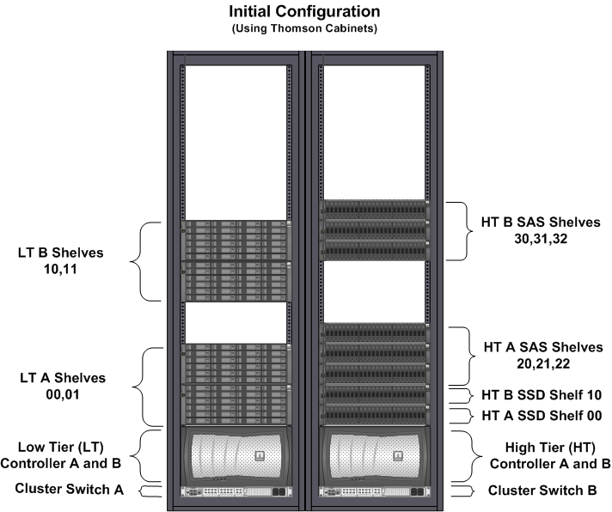
FAS6220 Primary – Initial Cabinet Layout

Slide 21
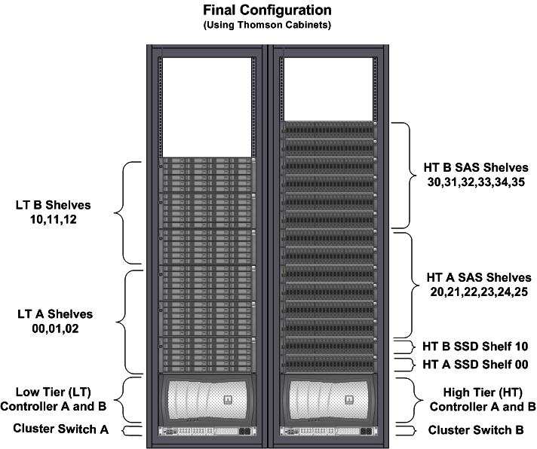
FAS6220 Primary – Final Cabinet Layout

Slide 22
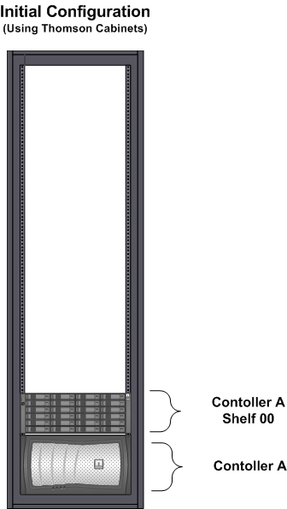
FAS6220 Backup – Initial Cabinet Layout

Slide 23
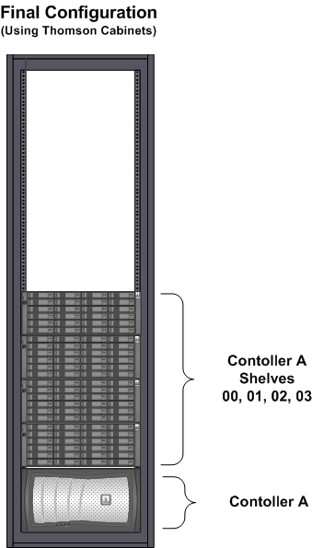
FAS6220 Backup - Final Cabinet Layout

Slide 24
High Tier Aggregate Sizing and Growth
ONTAP VERSION | Clustered ONTAP 8.2.1 or higher
LIMITATIONS | Maximum aggregate size of 324TB Maximum volume size of 70TB
AGGREGATE CONFIGURATION | Dedicated 3 disk root aggregate on each node is required One FlashPool data aggregate per node.
RAID GROUP SIZE | 11 SSD drives in their own raid group of the FlashPool aggregate 19 SAS drives per raid group in the FlashPool aggregate Note: aggregates should be grown in 9, 10, or 19 drive increments
INITIAL CONFIGURATION 6 DS2246 shelves | 1 root aggregate with 3 SAS drives per controller 1 data aggregate of 1 SSD raid group (11 drives) and 3.5 SAS raid groups (67 drives) per controller 2 spare drives per controller 27TB usable per controller = 54TB total
FINAL CONFIGURATION 12 DS2246 shelves | 1 root aggregate with 3 SAS drives per controller 1 data aggregate of 1 SSD raid group (11 drives) and 7 SAS raid groups (133 drives) per controller 8 spare drives per controller 56TB usable per controller = 112TB total

Slide 25
Low Tier Aggregate Sizing and Growth
ONTAP VERSION | Clustered ONTAP 8.2.1 or higher
LIMITATIONS | Maximum aggregate size of 324TB Maximum volume size of 70TB
AGGREGATE CONFIGURATION | Dedicated 3 disk root aggregate on each node is required One data aggregate per node.
RAID GROUP SIZE | 14 SATA drives per raid group in the data aggregate Note: aggregates should be grown in 8 or 14 drive increments
INITIAL CONFIGURATION 4 DS4246 shelves | 1 root aggregate with 3 SATA drives per controller 1 data aggregate of 3 raid groups (42 drives) per controller 3 spare drives per controller 52TB usable per controller = 104TB total
FINAL CONFIGURATION 6 DS4246 shelves | 1 root aggregate with 3 SATA drives per controller 1 data aggregate of 4.5 raid groups (64 drives) per controller 5 spare drives per controller 78TB usable per controller = 156TB total

Slide 26
Backup Aggregate Sizing and Growth
ONTAP VERSION | Clustered ONTAP 8.2.1 or higher
LIMITATIONS | Maximum aggregate size of 324TB Maximum volume size of 70TB 4 spare drives per node recommended for DS4486 shelves 8 cluster peers
AGGREGATE CONFIGURATION | Dedicated 3 disk root aggregate on each node is required 2 data aggregates per node.
RAID GROUP SIZE | 16 SATA drives per raid group in the data aggregate Note: aggregates should be grown in 9 or 16 drive increments
INITIAL CONFIGURATION 1 DS4486 shelf | 1 root aggregate with 3 SATA drives 1 data aggregate of 2.5 raid groups (41 drives) 4 spare drives per controller 114TB usable
FINAL CONFIGURATION 4 DS4486 shelves | 1 root aggregate with 3 SATA drives 1 data aggregates of 5.5 raid groups (89 drives) 1 data aggregates of 6 raid groups (96 drives) 4 spare drives per controller 523TB usable

